Slide 1

CHAPTER 10
THEORY OF GRAPHS AND TREES
Copyright © Cengage Learning. All rights reserved.

Slide 2

10.1
Trails, Paths, and Circuits
Copyright © Cengage Learning. All rights reserved.

Slide 3
Trails, Paths, and Circuits
The subject of graph theory began in the year 1736 when the great mathematician Leonhard Euler published a paper giving the solution to the following puzzle:
The town of Königsberg in Prussia (now Kaliningrad in Russia) was built at a point where two branches of the Pregel River came together. It consisted of an island and some land along the river banks.

Slide 4
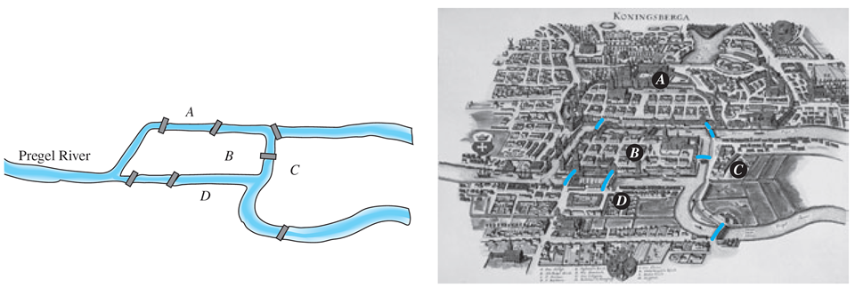
Trails, Paths, and Circuits
These were connected by seven bridges as shown in Figure 10.1.1.
The Seven Bridges of Königsberg
Figure 10.1.1

Slide 5
Trails, Paths, and Circuits
The question is this: Is it possible for a person to take a walk around town, starting and ending at the same location and crossing each of the seven bridges exactly once?
To solve this puzzle, Euler translated it into a graph theory problem. He noticed that all points of a given land mass can be identified with each other since a person can travel from any one point to any other point of the same land mass without crossing a bridge.

Slide 6
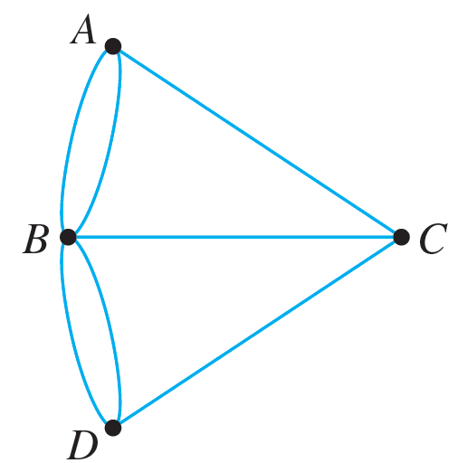
Trails, Paths, and Circuits
Thus for the purpose of solving the puzzle, the map of Königsberg can be identified with the graph shown in Figure 10.1.2, in which the vertices A, B, C, and D represent land masses and the seven edges represent the seven bridges.
Graph Version of Königsberg Map
Figure 10.1.2

Slide 7
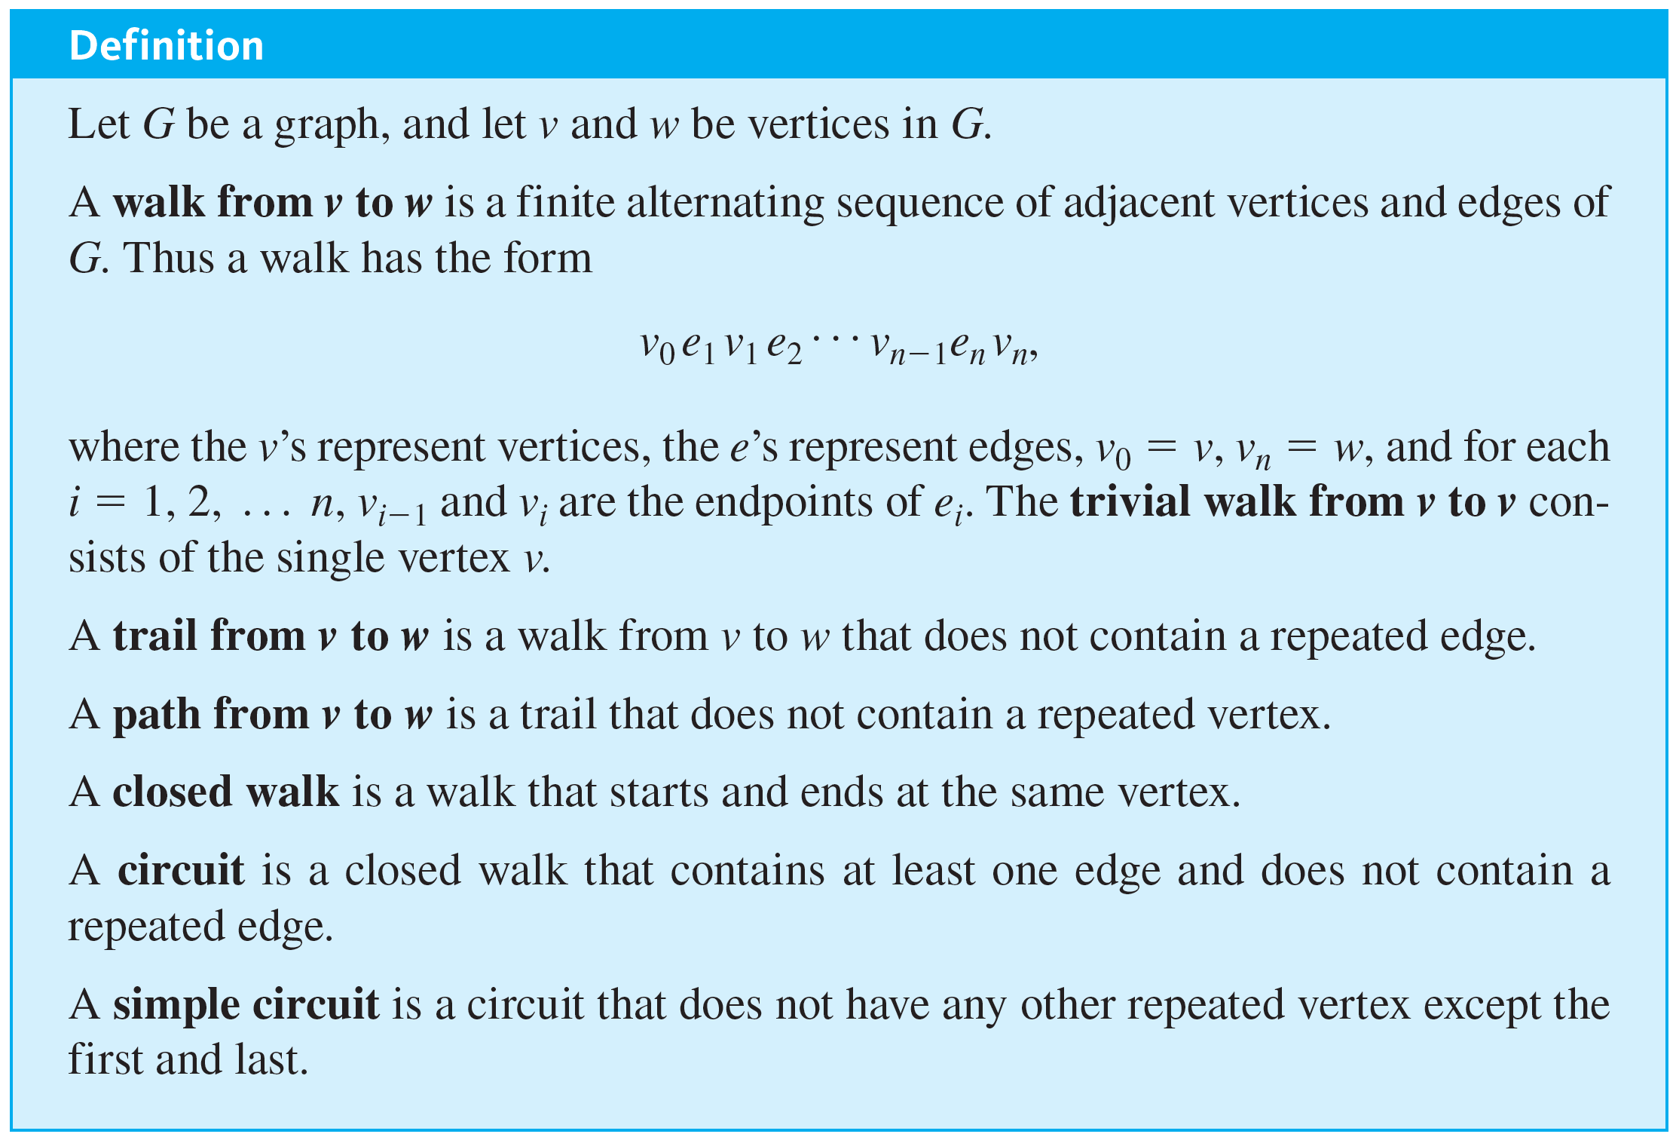
Trails, Paths, and Circuits

Slide 8
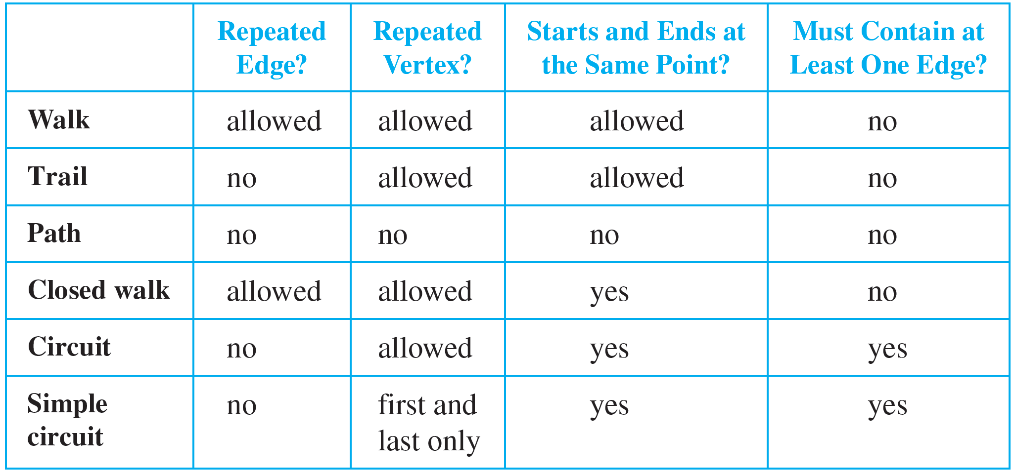
Trails, Paths, and Circuits
For ease of reference, these definitions are summarized in the following table:

Slide 9
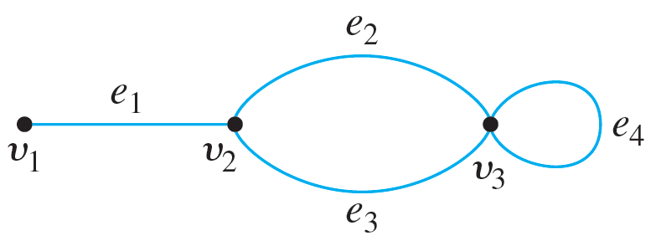
Example 10.1.1 – Notation for Walks
a. In the graph below, the notation e₁e₂e₄e₃ refers unambiguously to the following walk: v₁e₁v₂e₂v₃e₄v₃e₃v₂. On the other hand, the notation e₁ is ambiguous if used by itself to refer to a walk. It could mean either v₁e₁v₂ or v₂e₁v₁.

Slide 10
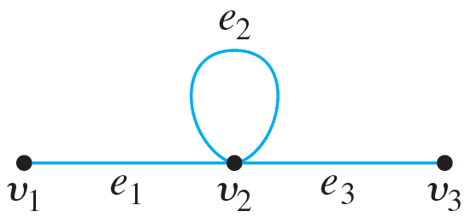
Example 10.1.1 – Notation for Walks
continued
b. In the graph of part (a), the notation v₂v₃ is ambiguous if used to refer to a walk. It could mean v₂e₂v₃ or v₂e₃v₃. On the other hand, in the graph below, the notation v₁v₂v₂v₃ refers unambiguously to the walk v₁e₁v₂e₂v₂e₃v₃.

Slide 11
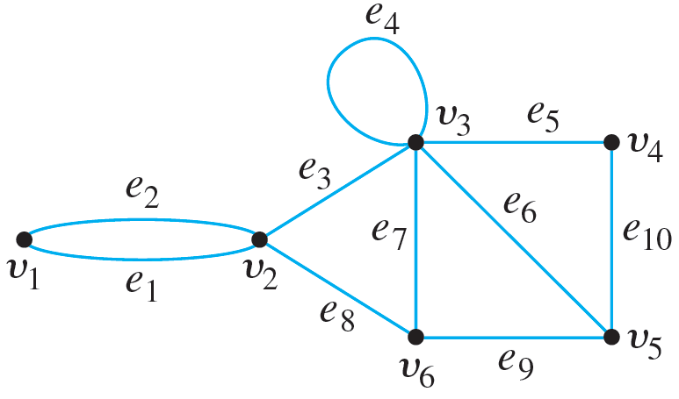
Example 10.1.2 – Walks, Trails, Paths, and Circuits
In the graph below, determine which of the following walks are trails, paths, circuits, or simple circuits.
a. v₁e₁v₂e₃v₃e₄v₃e₅v₄ b. e₁e₃e₅e₅e₆
c. v₂v₃v₄v₅v₃v₆v₂ d. v₂v₃v₄v₅v₆v₂
e. v₁e₁v₂e₁v₁ f . v₁

Slide 12
Example 10.1.2 – Solution
a. This walk has a repeated vertex but does not have a repeated edge, so it is a trail from v₁ to v₄ but not a path.
b. This is just a walk from v₁ to v₅. It is not a trail because it has a repeated edge.
c. This walk starts and ends at v₂, contains at least one edge, and does not have a repeated edge, so it is a circuit. Since the vertex v₃ is repeated in the middle, it is not a simple circuit.

Slide 13
Example 10.1.2 – Solution
continued
d. This walk starts and ends at v₂, contains at least one edge, does not have a repeated edge, and does not have a repeated vertex. Thus it is a simple circuit.
e. This is just a closed walk starting and ending at v₁. It is not a circuit because edge e₁ is repeated.
f. The first vertex of this walk is the same as its last vertex, but it does not contain an edge, and so it is not a circuit. It is a closed walk from v₁ to v₁. (It is also a trail from v₁ to v₁.)

Slide 14
Subgraphs

Slide 15
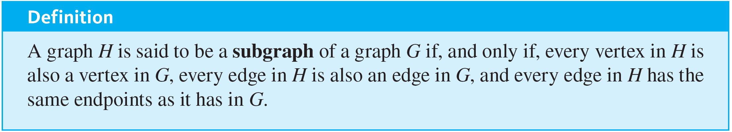
Subgraphs

Slide 16
Example 10.1.3 – Subgraphs
List all subgraphs of the graph G with vertex set {v₁, v₂} and edge set {e₁, e₂, e₃}, where the endpoints of e₁ are v₁ and v₂, the endpoints of e₂ are v₁ and v₂, and e₃ is a loop at v₁.

Slide 17
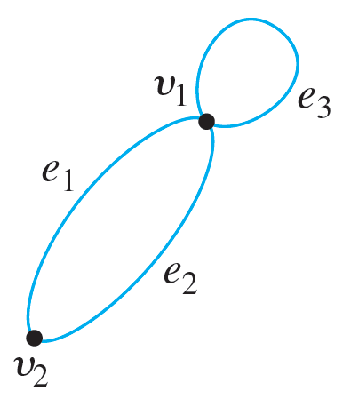
Example 10.1.3 – Solution
G can be drawn as shown below.
There are 11 subgraphs of G, which can be grouped according to those that do not have any edges, those that have one edge, those that have two edges, and those that have three edges.

Slide 18
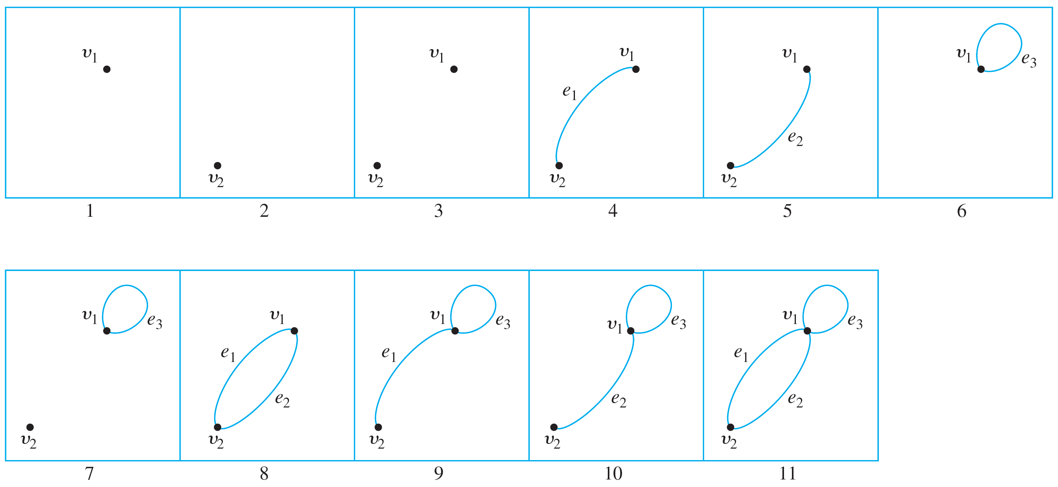
Example 10.1.3 – Solution
continued
The 11 subgraphs are shown in Figure 10.1.3.
Figure 10.1.3

Slide 19
Connectedness

Slide 20
Connectedness
It is easy to understand the concept of connectedness on an intuitive level. Roughly speaking, a graph is connected if it is possible to travel from any vertex to any other vertex along a sequence of adjacent edges of the graph.
The formal definition of connectedness is stated in terms of walks.

Slide 21
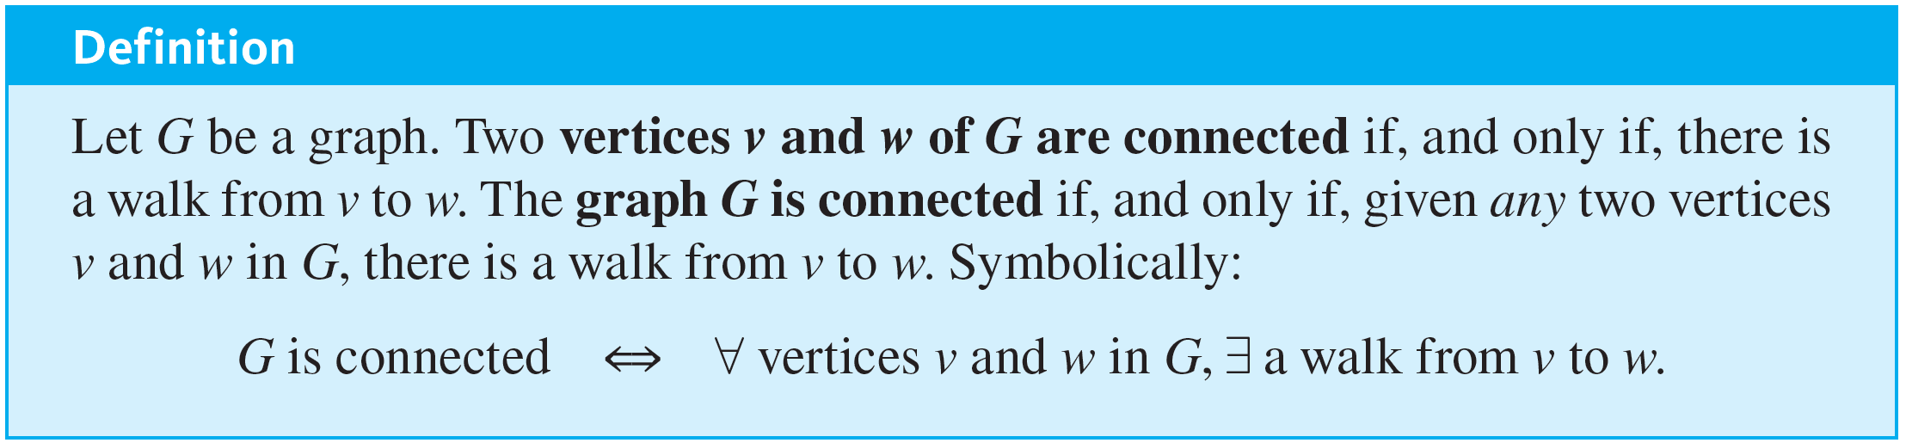
Connectedness
If you take the negation of this definition, you will see that a graph G is not connected if, and only if, there exist two vertices of G that are not connected by any walk.

Slide 22
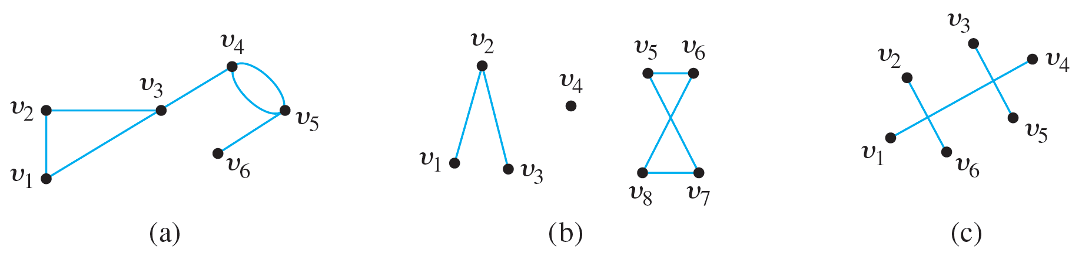
Example 10.1.4 – Connected and Disconnected Graphs
Which of the following graphs are connected?

Slide 23
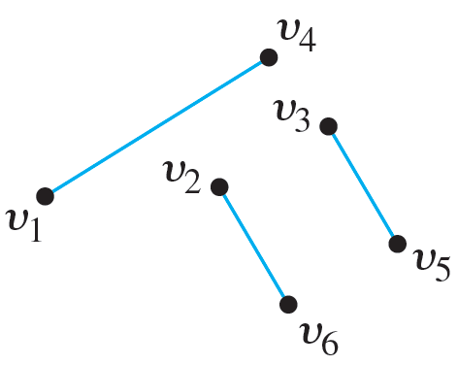
Example 10.1.4 – Solution
The graph represented in (a) is connected, whereas those of (b) and (c) are not. To understand why (c) is not connected, recall that in a drawing of a graph, two edges may cross at a point that is not a vertex. Thus the graph in (c) can be redrawn as follows:

Slide 24
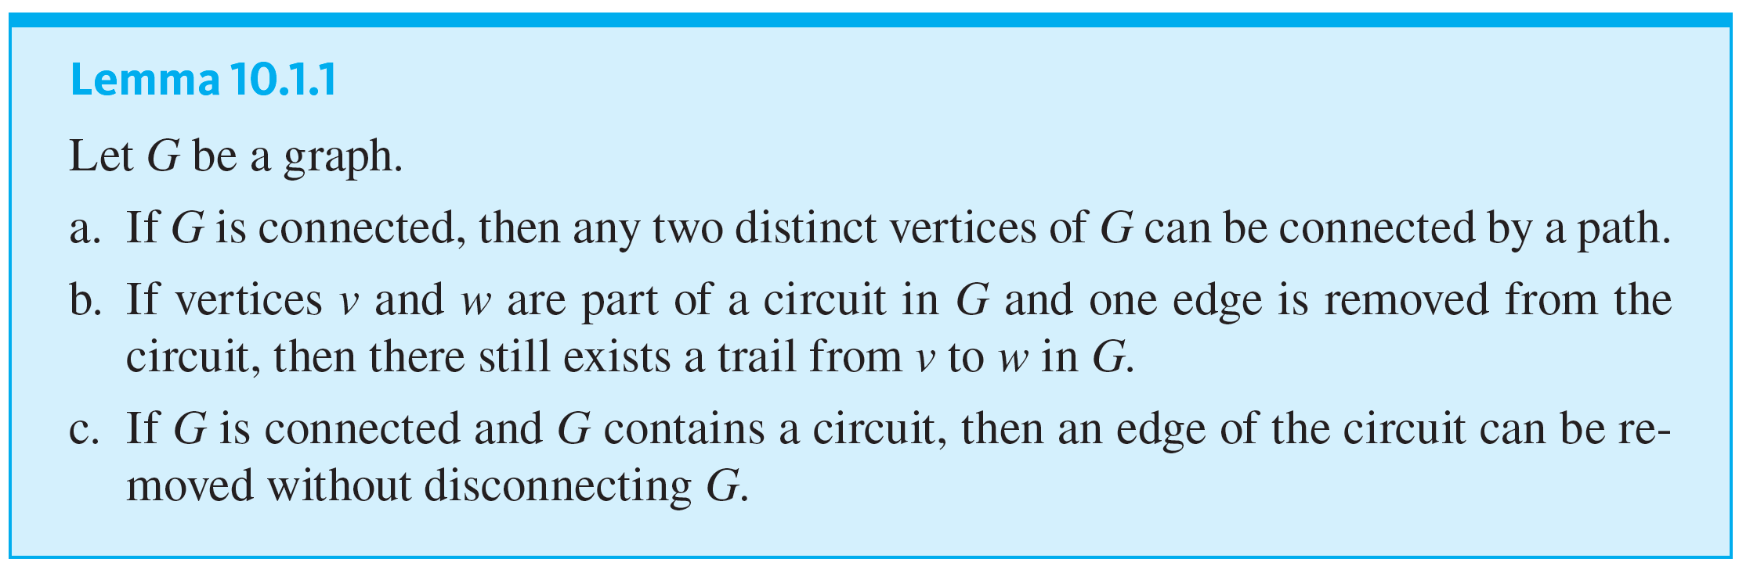
Connectedness
Some useful facts relating circuits and connectedness are collected in the following lemma.

Slide 25
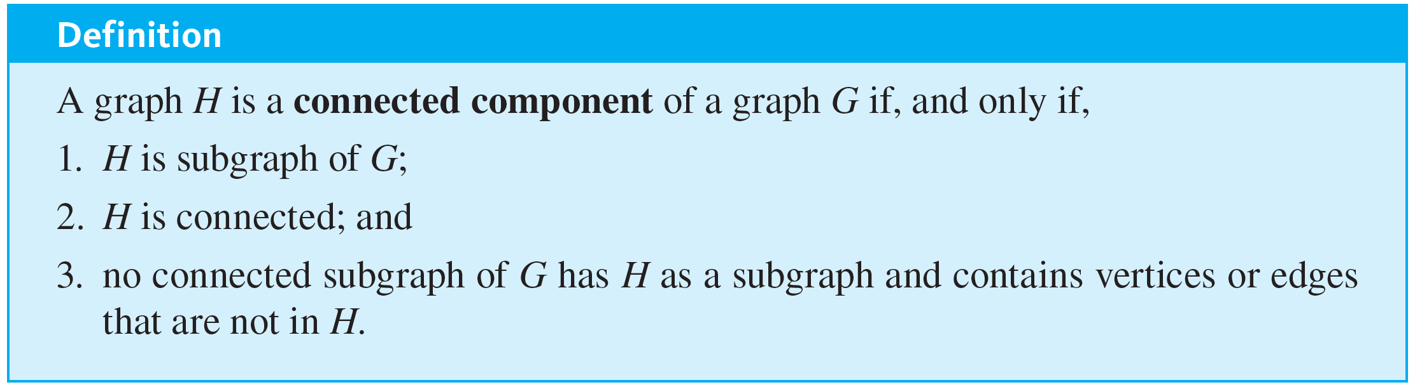
Connectedness
A connected component of a graph is a connected subgraph of largest possible size.

Slide 26
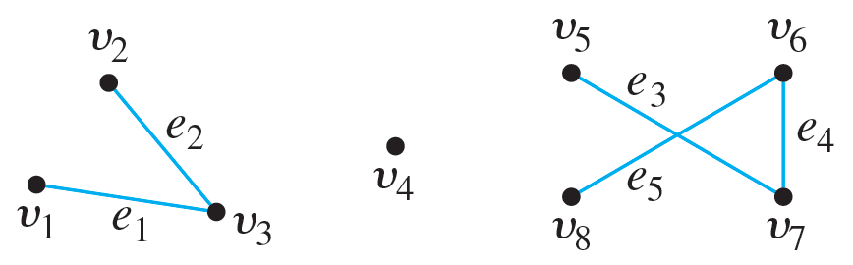
Example 10.1.5 – Connected Components
Find all connected components of the following graph G.

Slide 27

Example 10.1.5 – Solution
G has three connected components: H₁, H₂, and H₃ with vertex sets V₁, V₂, and V₃ and edge sets E₁, E₂, and E₃, where
V₁ = {v₁, v₂, v₃}, E₁ = {e₁, e₂},
V₂ = {v₄}, E₂ =
V₃ = {v₅, v₆, v₇, v₈}, E₃ = {e₃, e₄, e₅}.

Slide 28
Euler Circuits

Slide 29
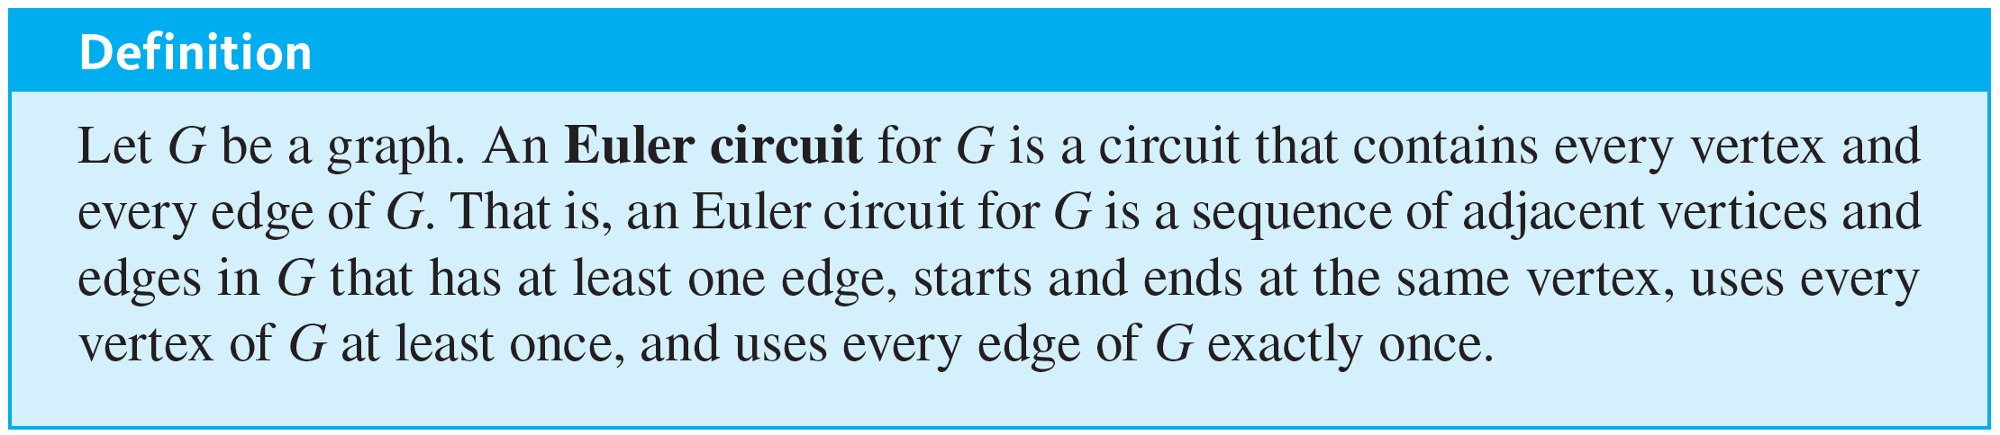
Euler Circuits
Now we return to consider general problems similar to the puzzle of the Königsberg bridges. The following definition is made in honor of Euler.

Slide 30
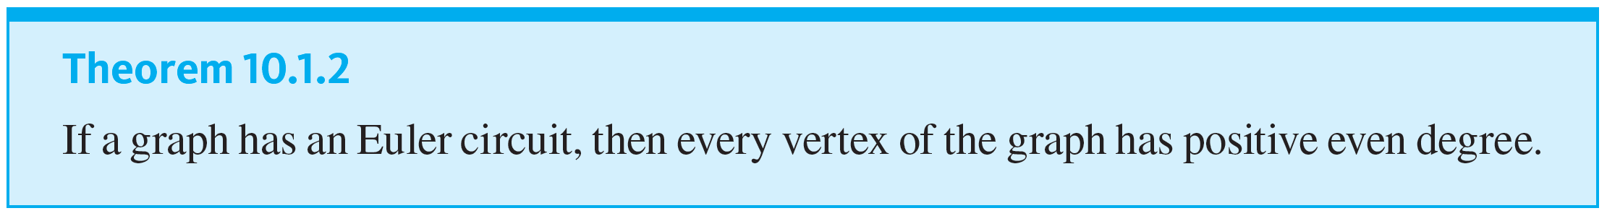

Euler Circuits
The analysis used earlier to solve the puzzle of the Königsberg bridges generalizes to prove the following theorem:

Slide 31
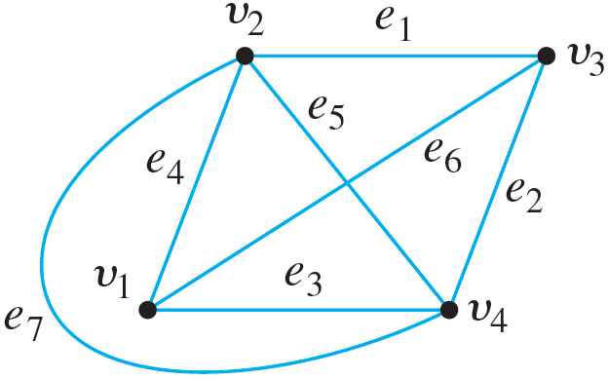
Example 10.1.6 – Showing That a Graph Does Not Have an Euler Circuit
Show that the graph below does not have an Euler circuit.

Slide 32
Example 10.1.6 – Solution
Vertices v₁ and v₃ both have degree 3, which is odd. Hence by (the contrapositive form of) Theorem 10.1.2, this graph does not have an Euler circuit.

Slide 33
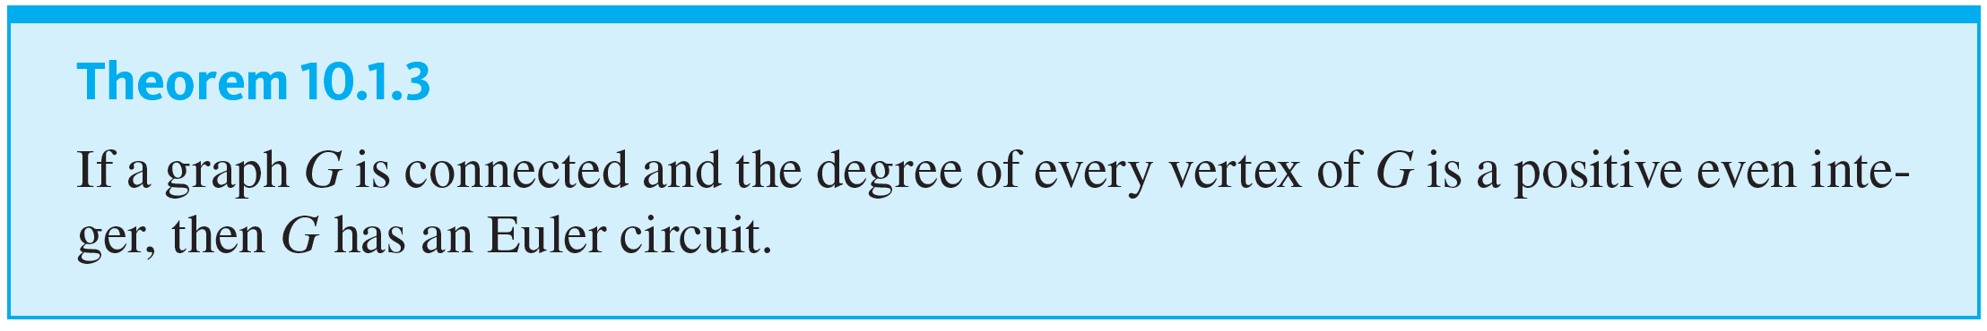
Euler Circuits

Slide 34
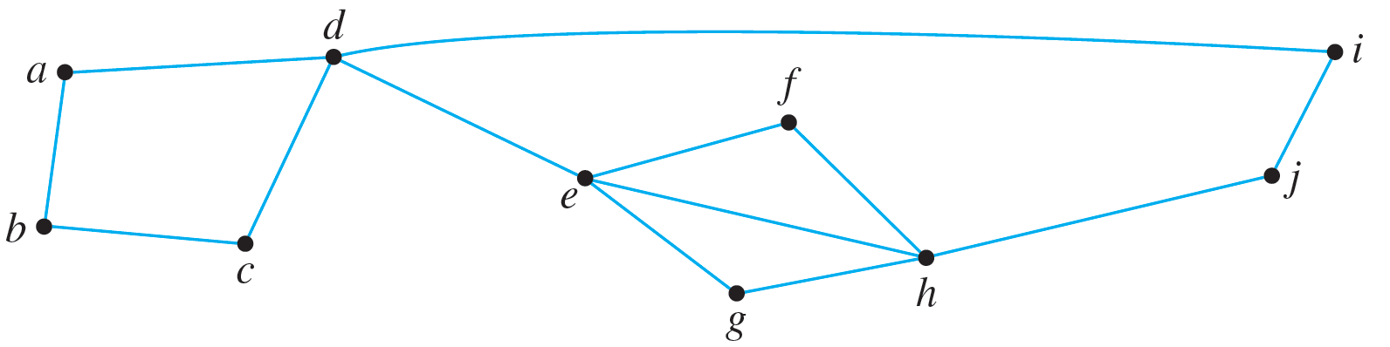
Example 10.1.7 – Finding an Euler Circuit
Use Theorem 10.1.3 to check that the graph below has an Euler circuit. Then use the algorithm from the proof of the theorem to find an Euler circuit for the graph.

Slide 35
Example 10.1.7 – Solution
Observe that
deg(a) = deg(b) = deg(c) = deg(f) = deg(g) = deg(i) =
deg(j) = 2
and that deg(d) = deg(e) = deg(h) = 4.
Hence all vertices have even degree. Also, the graph is connected. Thus, by Theorem 10.1.3, the graph has an Euler circuit.

Slide 36
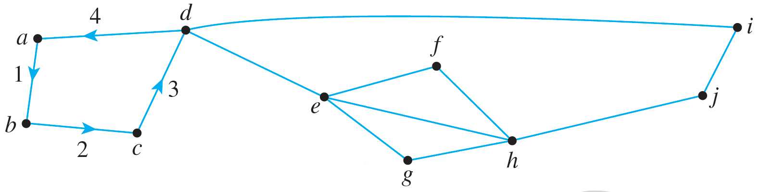
Example 10.1.7 – Solution
continued
To construct an Euler circuit using the algorithm of Theorem 10.1.3, let v = a and let C be
C: abcda.
C is represented by the labeled edges shown below.

Slide 37
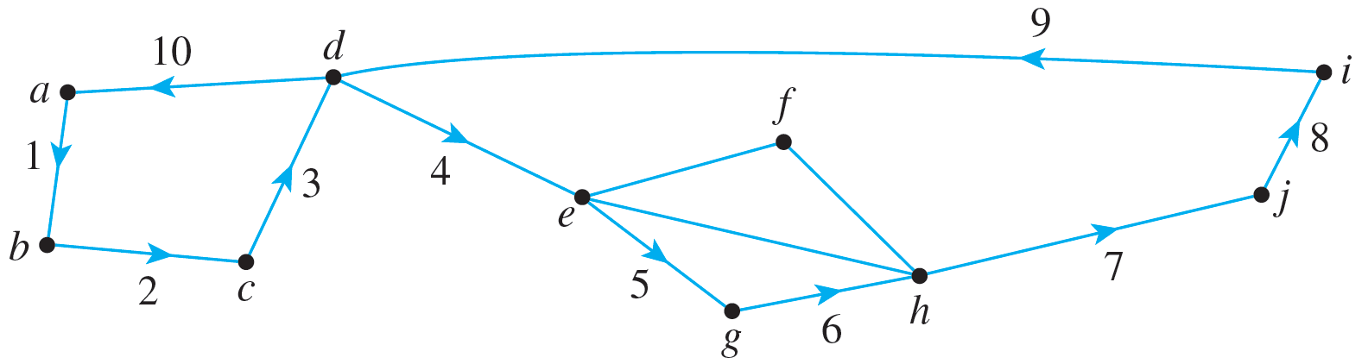
Example 10.1.7 – Solution
continued
Observe that C is not an Euler circuit for the graph but that C intersects the rest of the graph at d. Let C′ be C′: deghjid.
Patch C′ into C to obtain C″: abcdeghjida.
Set C = C″. Then C is represented by the labeled edges shown below.

Slide 38
Example 10.1.7 – Solution
continued
Observe that C is not an Euler circuit for the graph but that it intersects the rest of the graph at e and h. Let C′ be
C′: efhe.
Patch C′ into C to obtain
C″: abcdefheghjida.

Slide 39
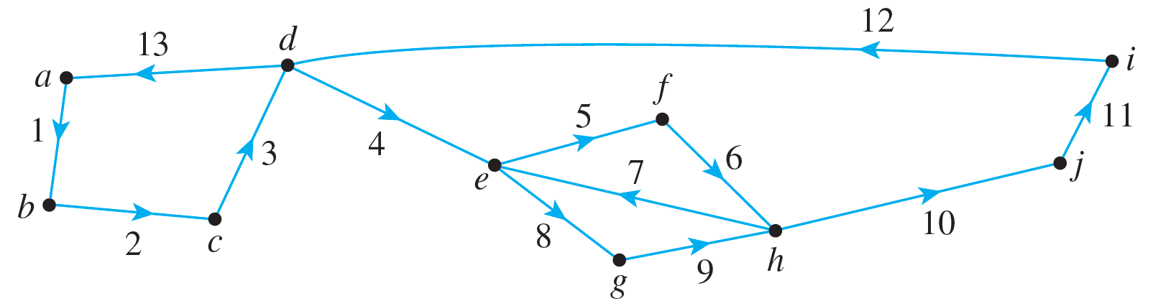
Example 10.1.7 – Solution
continued
Set C = C″. Then C is represented by the labeled edges shown below.
Since C includes every edge of the graph exactly once, C is an Euler circuit for the graph.

Slide 40
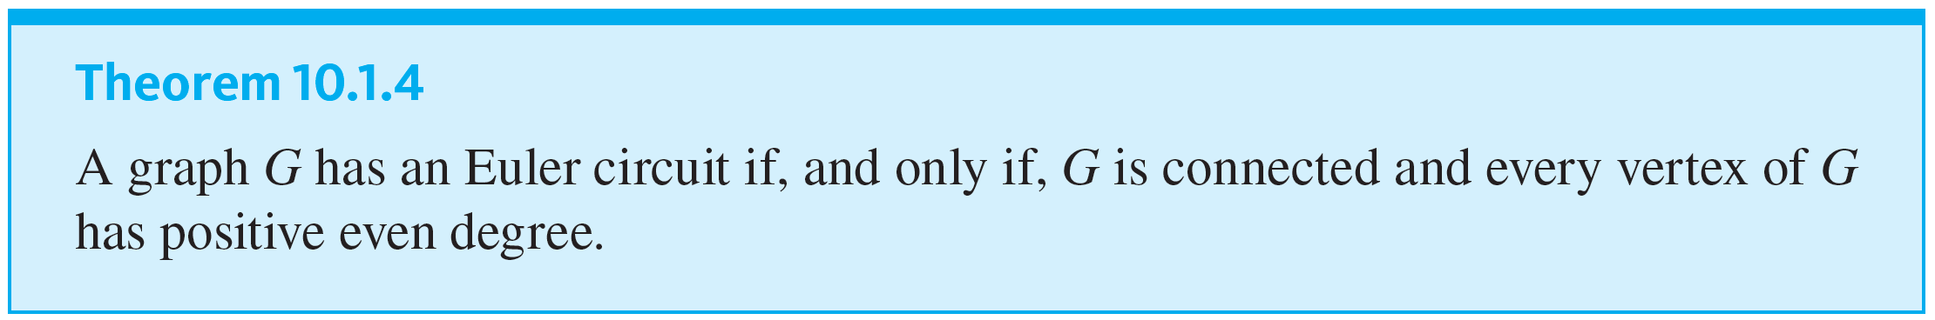
Euler Circuits
A corollary to Theorem 10.1.4 gives a criterion for determining when it is possible to find a walk from one vertex of a graph to another, passing through every vertex of the graph at least once and every edge of the graph exactly once.

Slide 41
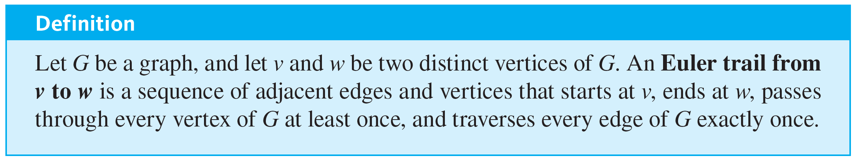
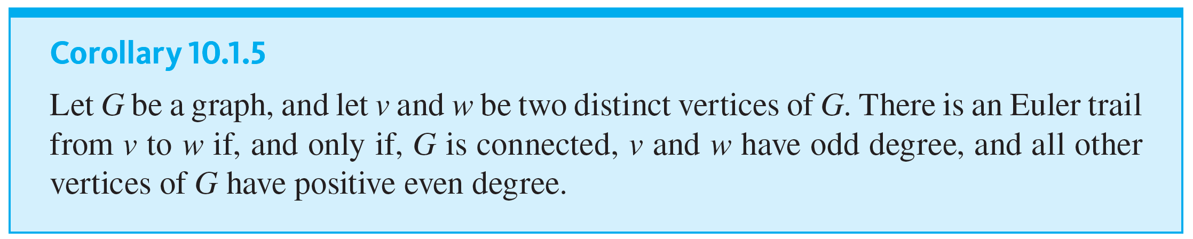
Euler Circuits

Slide 42
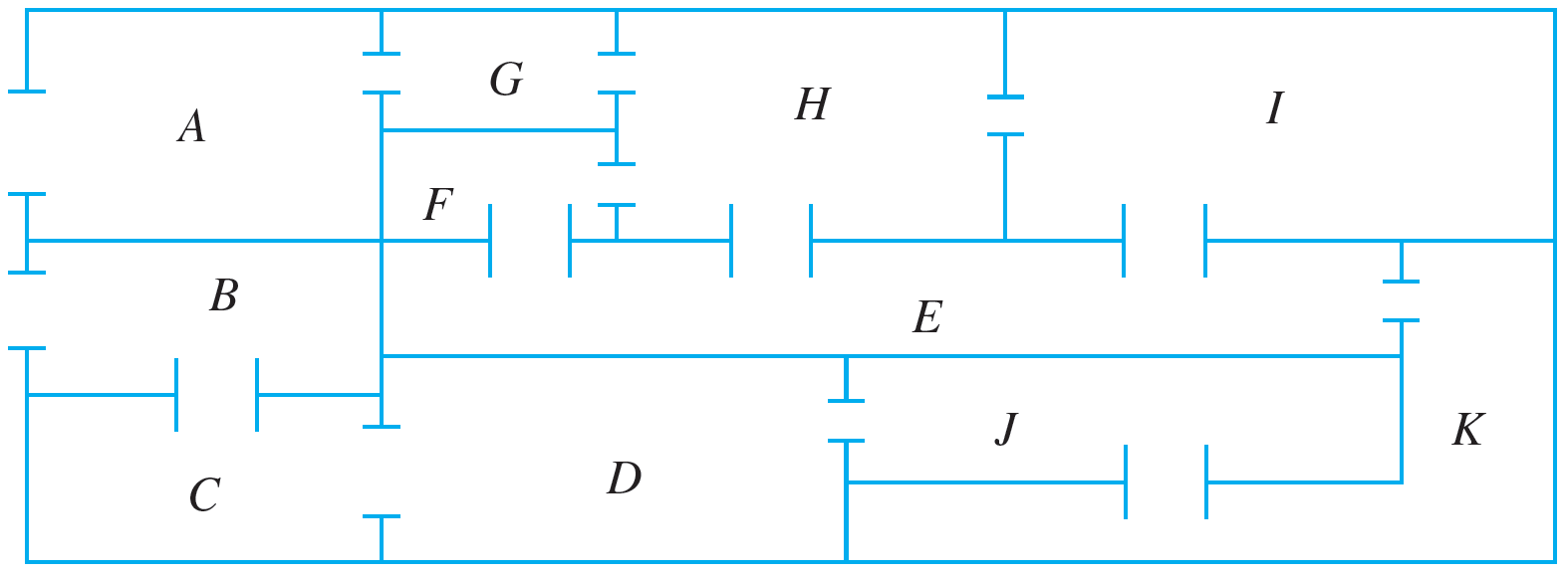
Example 10.1.8 – Finding an Euler Trail
The floor plan shown below is for a house that is open for public viewing. Is it possible to find a trail that starts in room A, ends in room B, and passes through every interior doorway of the house exactly once? If so, find such a trail.

Slide 43
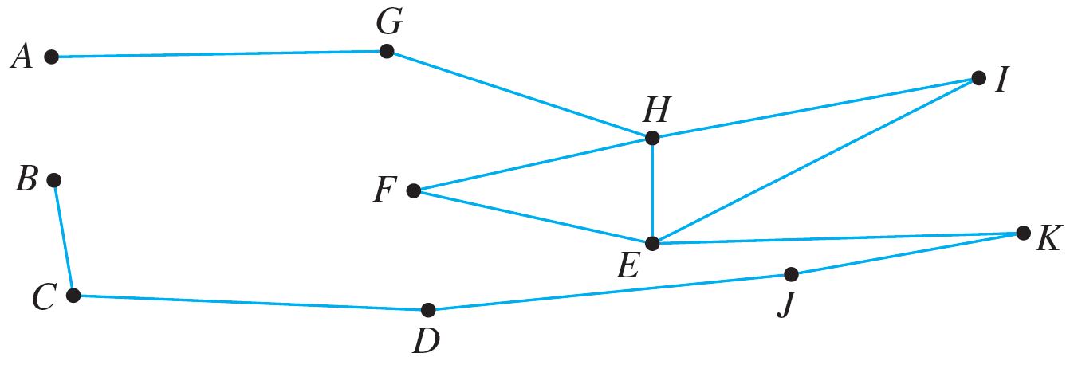
Example 10.1.8 – Solution
Let the floor plan of the house be represented by the graph below, where the edges indicate the openings between the rooms.
Each vertex of this graph has even degree except for A and B, each of which has degree 1. Hence by Corollary 10.1.5, there is an Euler trail from A to B. One such trail is
A G H F E I H E K J D C B.

Slide 44
Hamiltonian Circuits

Slide 45
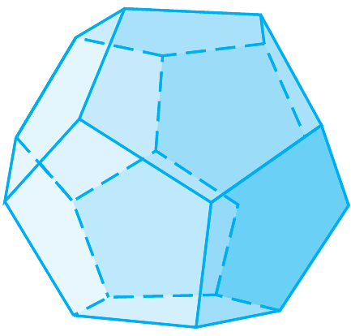
Hamiltonian Circuits
In 1859 the Irish mathematician Sir William Rowan Hamilton introduced a puzzle in the shape of a dodecahedron (DOH-dek-a-HEE-dron). (Figure 10.1.7 contains a drawing of a dodecahedron, which is a solid figure with 12 identical pentagonal faces.)
Dodecahedron
Figure 10.1.7

Slide 46
Hamiltonian Circuits
Each vertex was labeled with the name of a city—London, Paris, Hong Kong, New York, and so on.
The problem Hamilton posed was to start at one city and tour the world by visiting each other city exactly once and returning to the starting city.

Slide 47
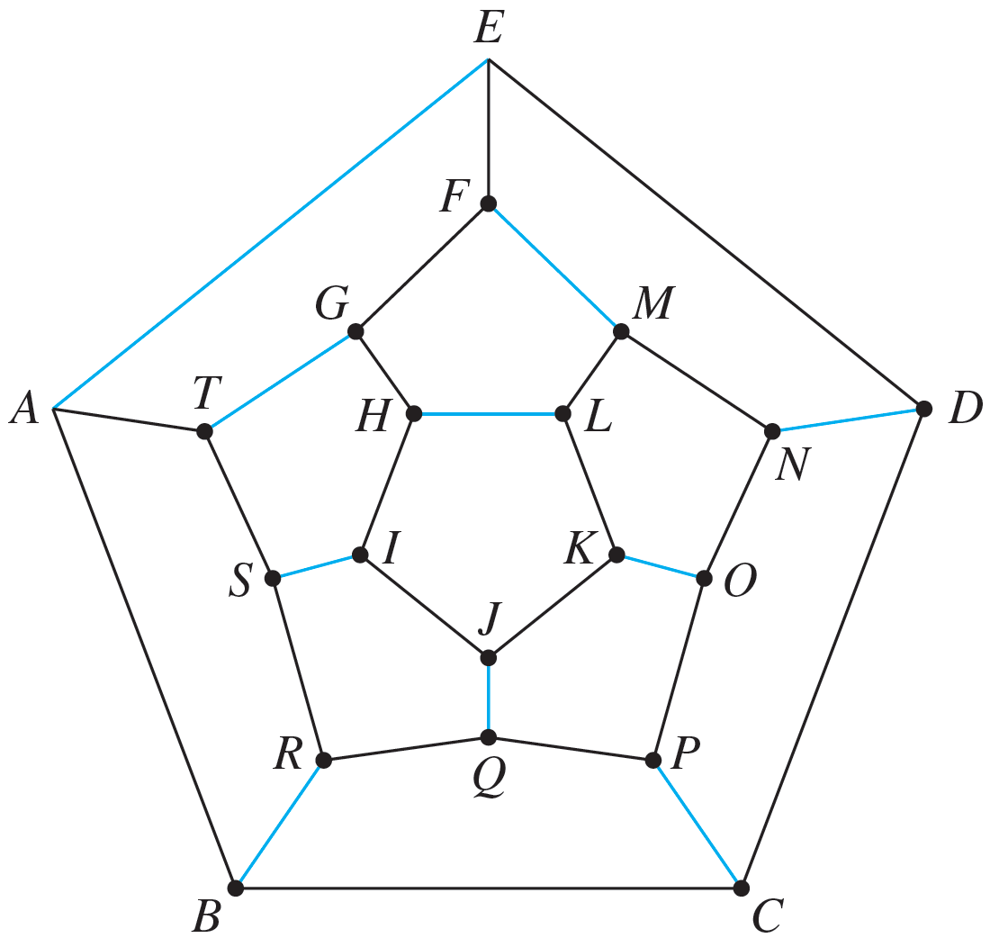
Hamiltonian Circuits
One way to solve the puzzle is to imagine the surface of the dodecahedron stretched out and laid flat in the plane, as follows:
One solution is the circuit
A B C D E F G H I J K L M N O P Q R S T A,
whose edges are indicated with black lines.

Slide 48
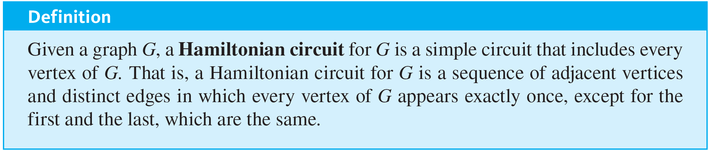
Hamiltonian Circuits
Note that although every city is visited, many edges are omitted from the circuit. (More difficult versions of the puzzle required that certain cities be visited in a certain order.)
The following definition is made in honor of Hamilton.

Slide 49
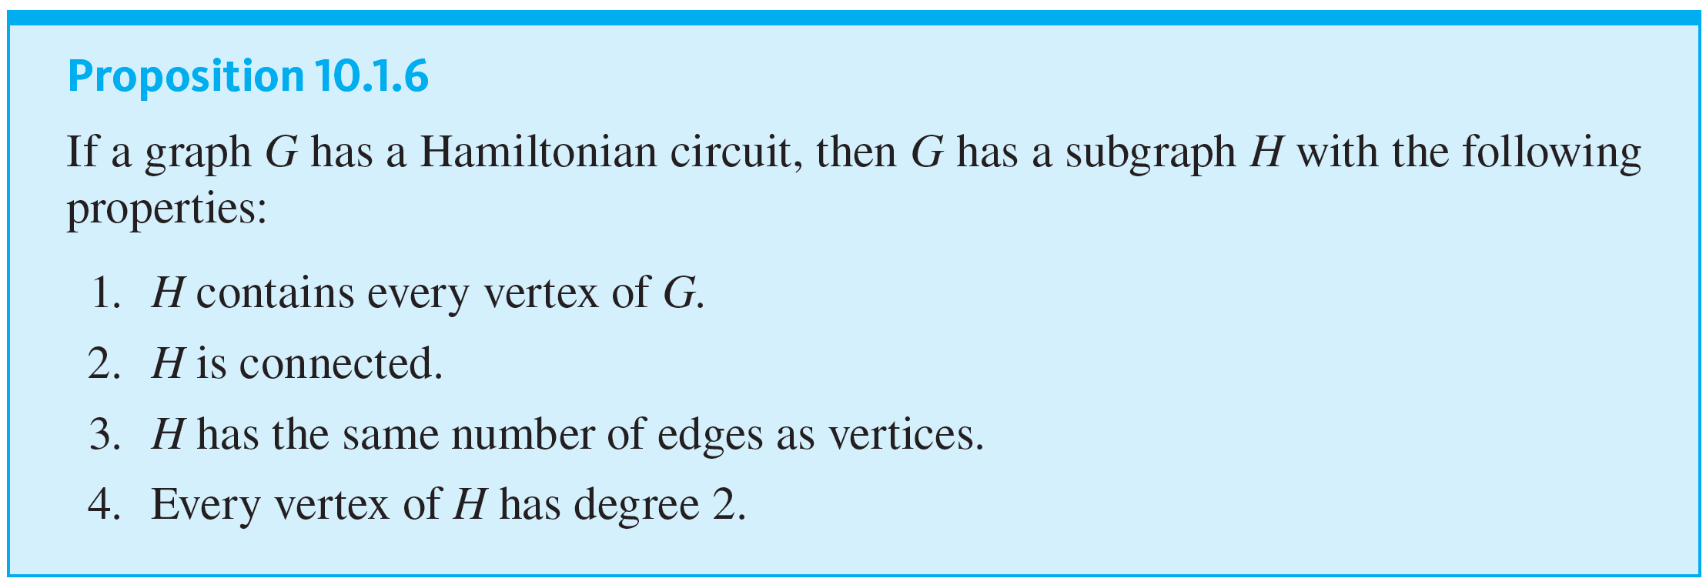
Hamiltonian Circuits

Slide 50
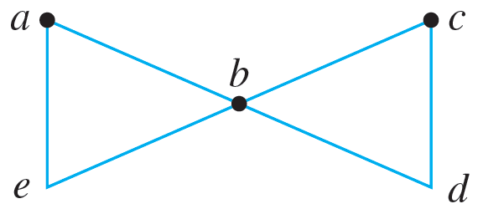
Example 10.1.9 – Showing That a Graph Does Not Have a Hamiltonian Circuit
Prove that the graph G shown below does not have a Hamiltonian circuit.

Slide 51
Example 10.1.9 – Solution
If G has a Hamiltonian circuit, then by Proposition 10.1.6, G has a subgraph H that (1) contains every vertex of G, (2) is connected, (3) has the same number of edges as vertices, and (4) is such that every vertex has degree 2. Suppose such a subgraph H exists.
In other words, suppose there is a connected subgraph H of G such that H has five vertices (a, b, c, d, e) and five edges and such that every vertex of H has degree 2.

Slide 52
Example 10.1.9 – Solution
continued
Since the degree of b in G is 4 and every vertex of H has degree 2, two edges incident on b must be removed from G to create H. Edge {a, b} cannot be removed because if it were, vertex a would have degree less than 2 in H. Similar reasoning shows that edges {e, b}, {b, a}, and {b, d} cannot be removed either.
It follows that the degree of b in H must be 4, which contradicts the condition that every vertex in H has degree 2 in H. Hence no such subgraph H exists, and so G does not have a Hamiltonian circuit.

Slide 53
Hamiltonian Circuits
The next example illustrates a type of problem known as a traveling salesman problem. It is a variation of the problem of finding a Hamiltonian circuit for a graph.

Slide 54
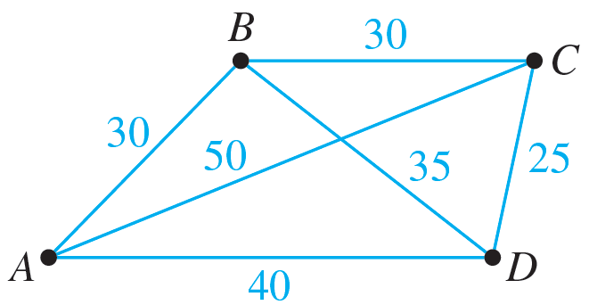
Example 10.1.10 – A Traveling Salesman Problem
Imagine that the drawing below is a map showing four cities and the distances in kilometers between them. Suppose that a salesman must travel to each city exactly once, starting and ending in city A. Which route from city to city will minimize the total distance that must be traveled?

Slide 55
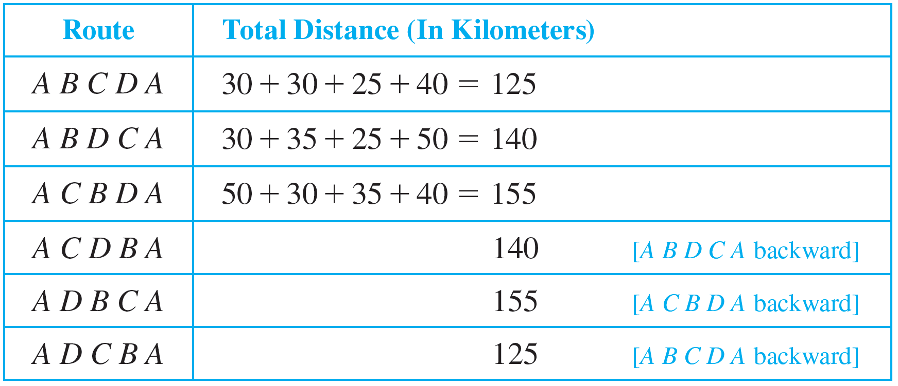
Example 10.1.10 – Solution
This problem can be solved by writing all possible Hamiltonian circuits starting and ending at A and calculating the total distance traveled for each.
Thus either route A B C D A or A D C B A gives a minimum total distance of 125 kilometers.

